Slide 1

Background muons separation
Artyom Gromov
Notes:
In this presentation I want to briefly report about results of muons separation for SHiP experiment using ml methods. The problem is to separate bakgrond muons which escaped magnetic trap from signak muons which are result of dark mater particles decay.

Slide 2

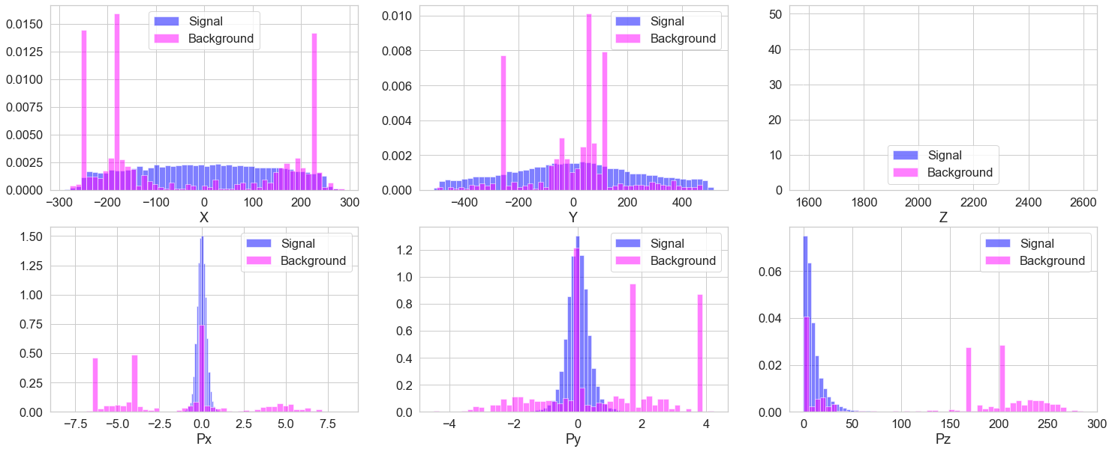
Dataset Description
Notes:
So there is dataset of generated particles. Each particle has six parametrs (three coordinatse and three momentum projections). For the futere research only fife were used (momentum and x, y coordinates). On this slide distributon of features for both kinds of particles.

Slide 3
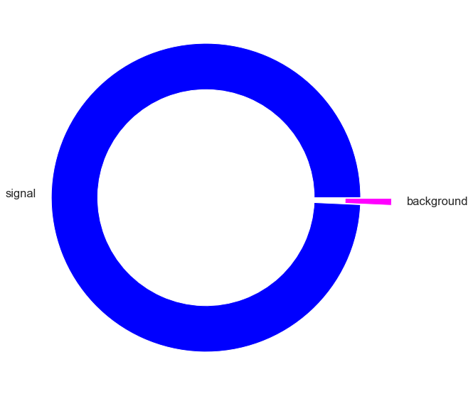
Dataset Description
Notes:
The big problem of this dataset is that it is not very imbalanced.

Slide 4
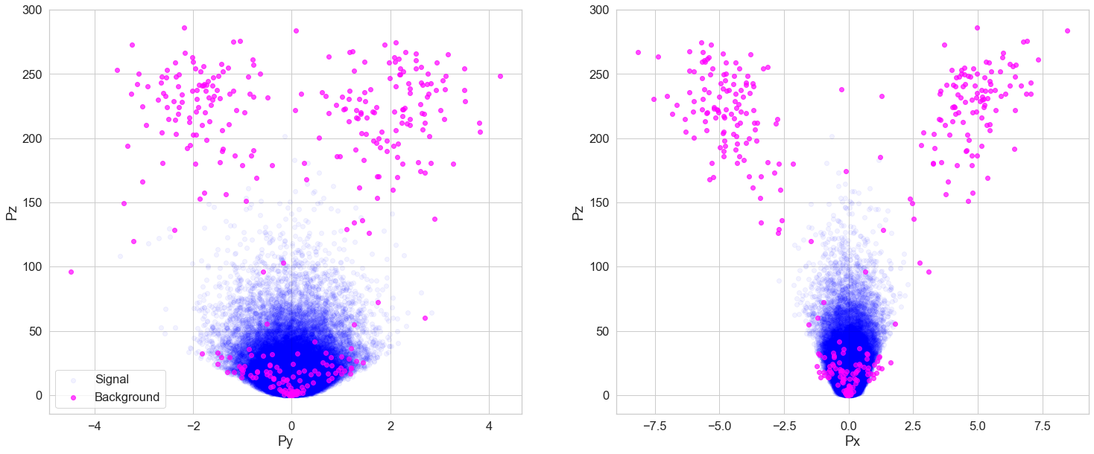
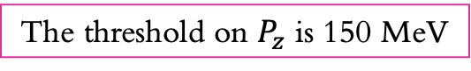
Dataset Description
The threshold on $P_{z}$ is 150 MeV
Notes:
From scatters of features and Pz histogram it could be concluded that main problem in this task is to classify muons of low energy. So for next analysis the threshold on Pz in 150 MeV was set

Slide 5
Metrics and Algorithms
Algorithms:
Logistic regresion
Randomn forest
Gradient boosting
Metrics:
ROC-curve and AUC
Notes:
To mesure the quality of uor models the ROC-AUC metrics was choosen. It allows to analyze efficiency of models for differen decision thresholds which good for imbalanced dataset. I used Logistic Regression and non linear algorithms Randomn Forest and Gradient boosting

Slide 6
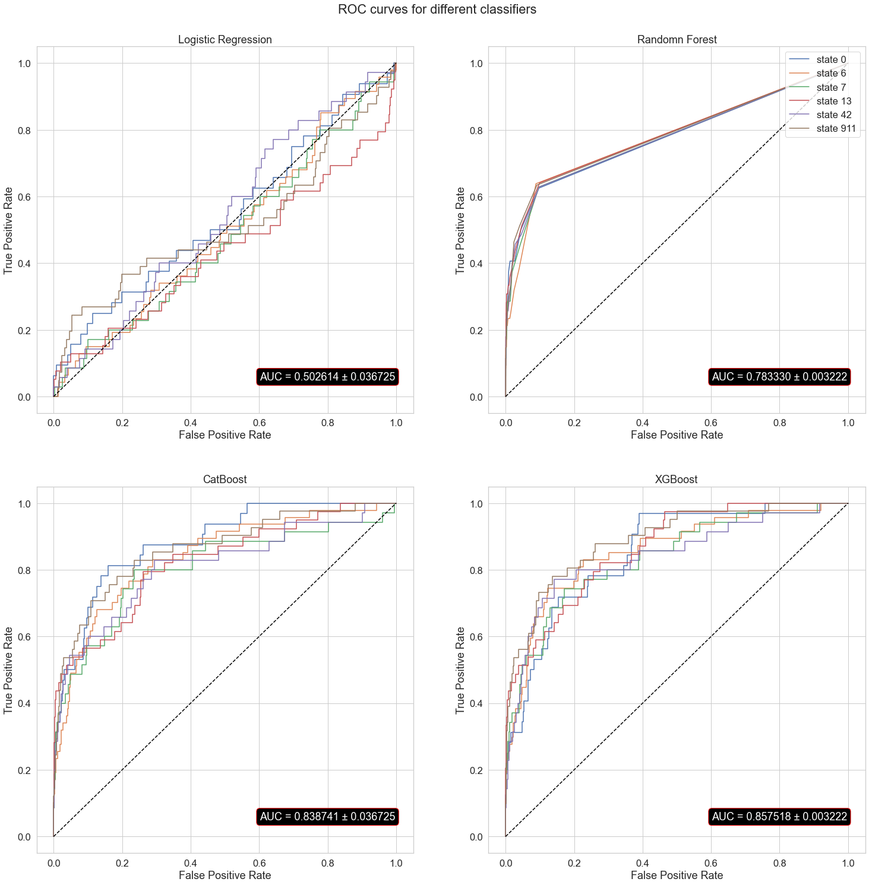
Models’ Learning and Data Processing
Notes:
On this slide the metric values are present for the row data

Slide 7
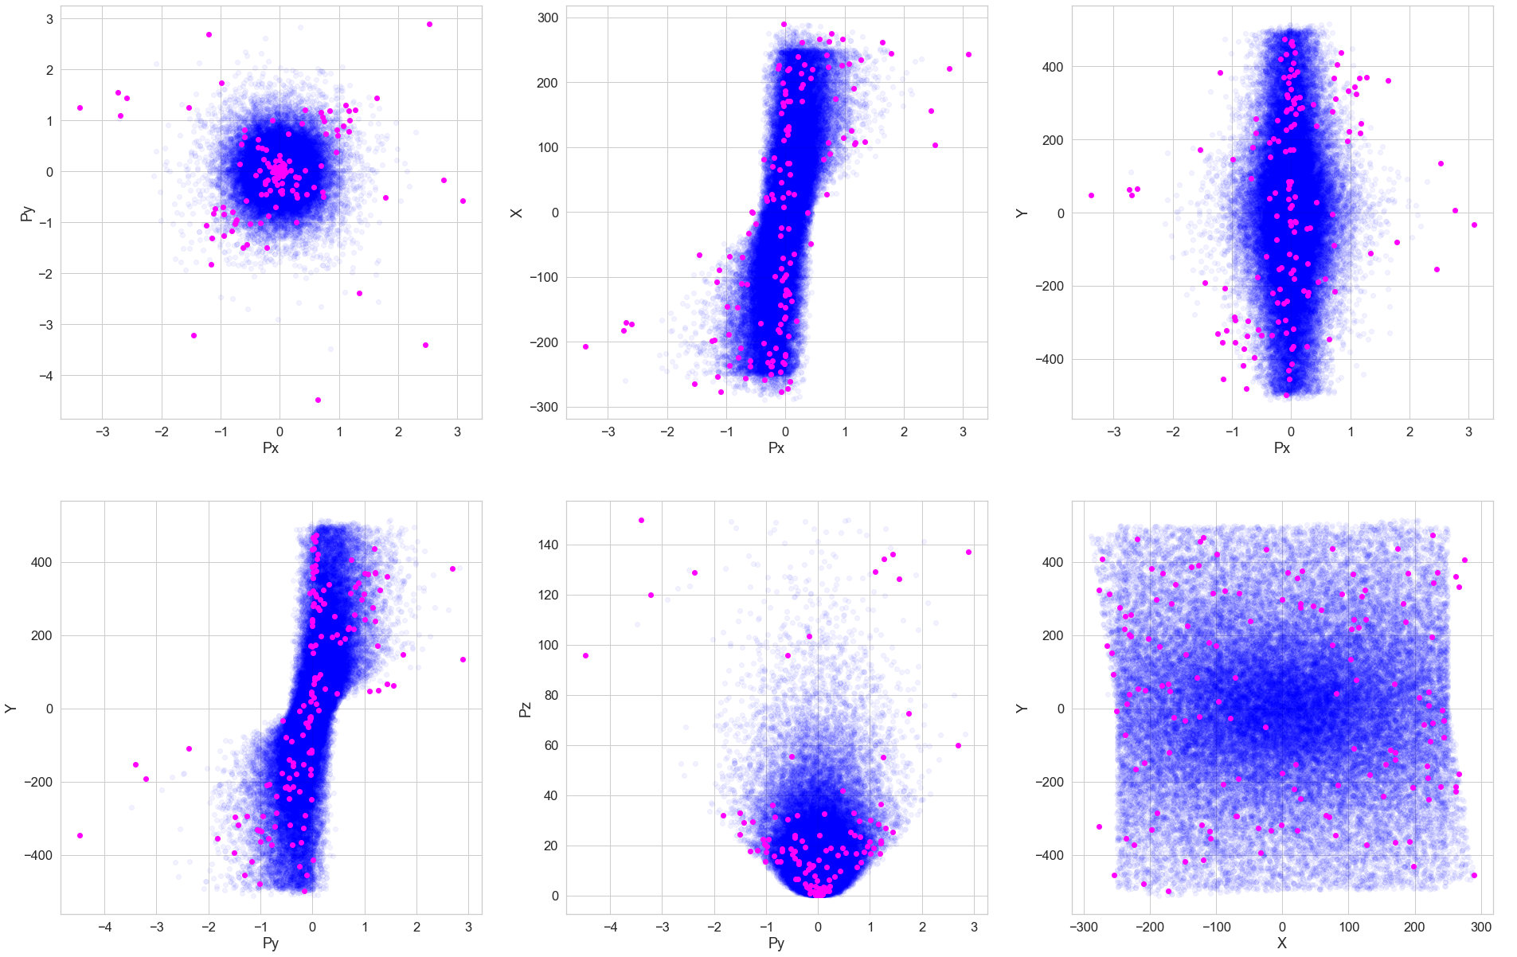
Notes:
Loking on these scatters I distinguished three groups of particles depend on their energy. So each of them was researched individualy

Slide 8
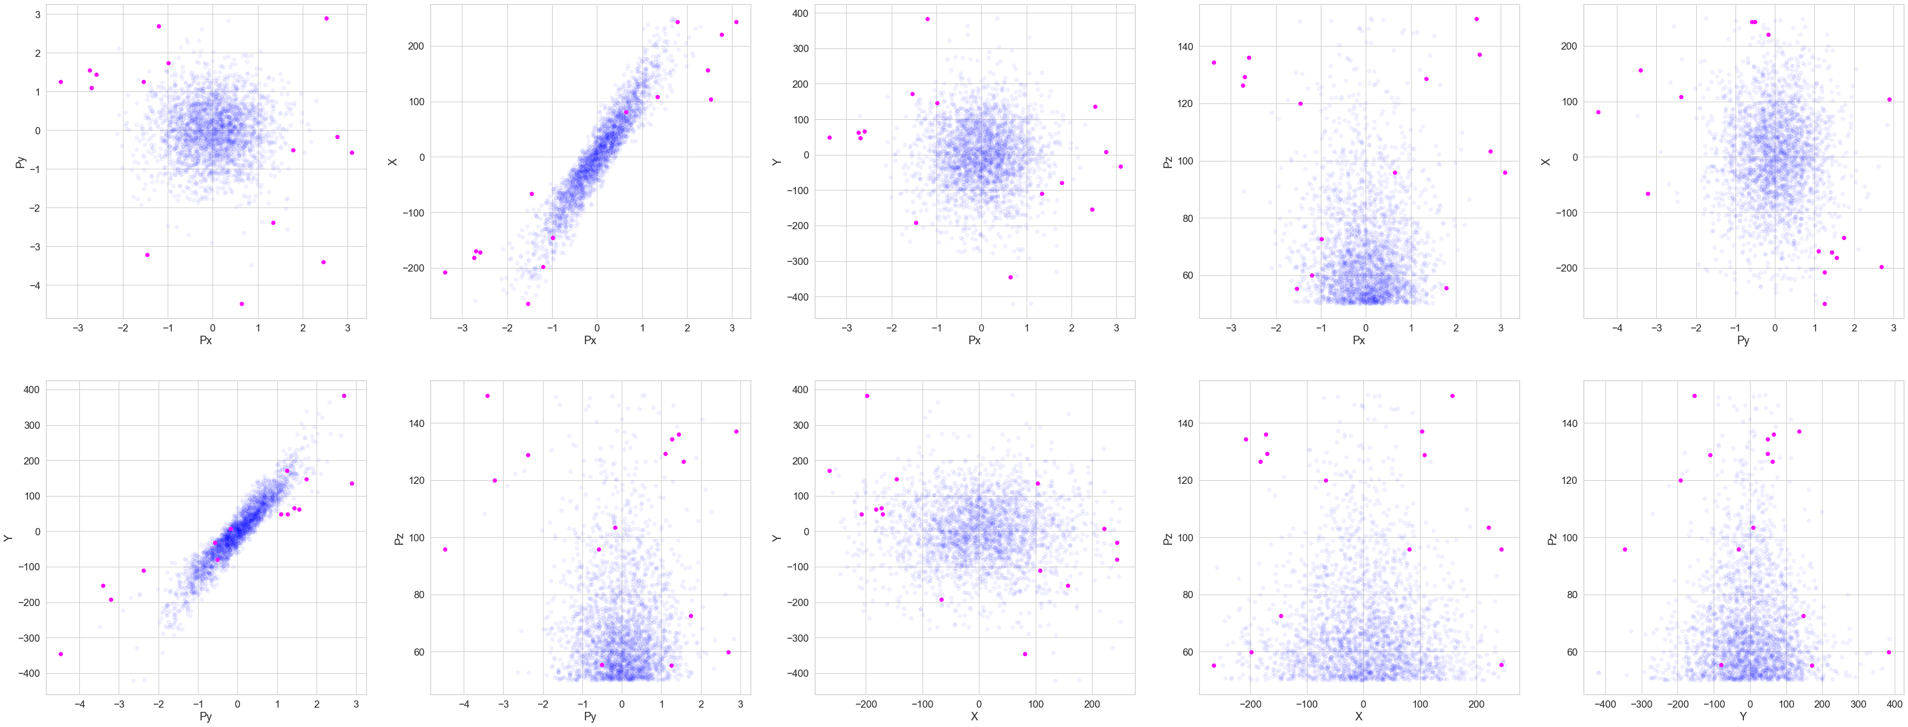
First Group (>50 Mev)
Notes:
The first group consists of particles with Pz grater than 50 MeV. According to scatters backgrond particles of such energy are far then signal ones& So I add new feature wich describes that. Also the feature describin f the distance from straigt line (Px, X) was used. To compensate the imbalance of the dataset SMOTE oversampling was used.

Slide 9
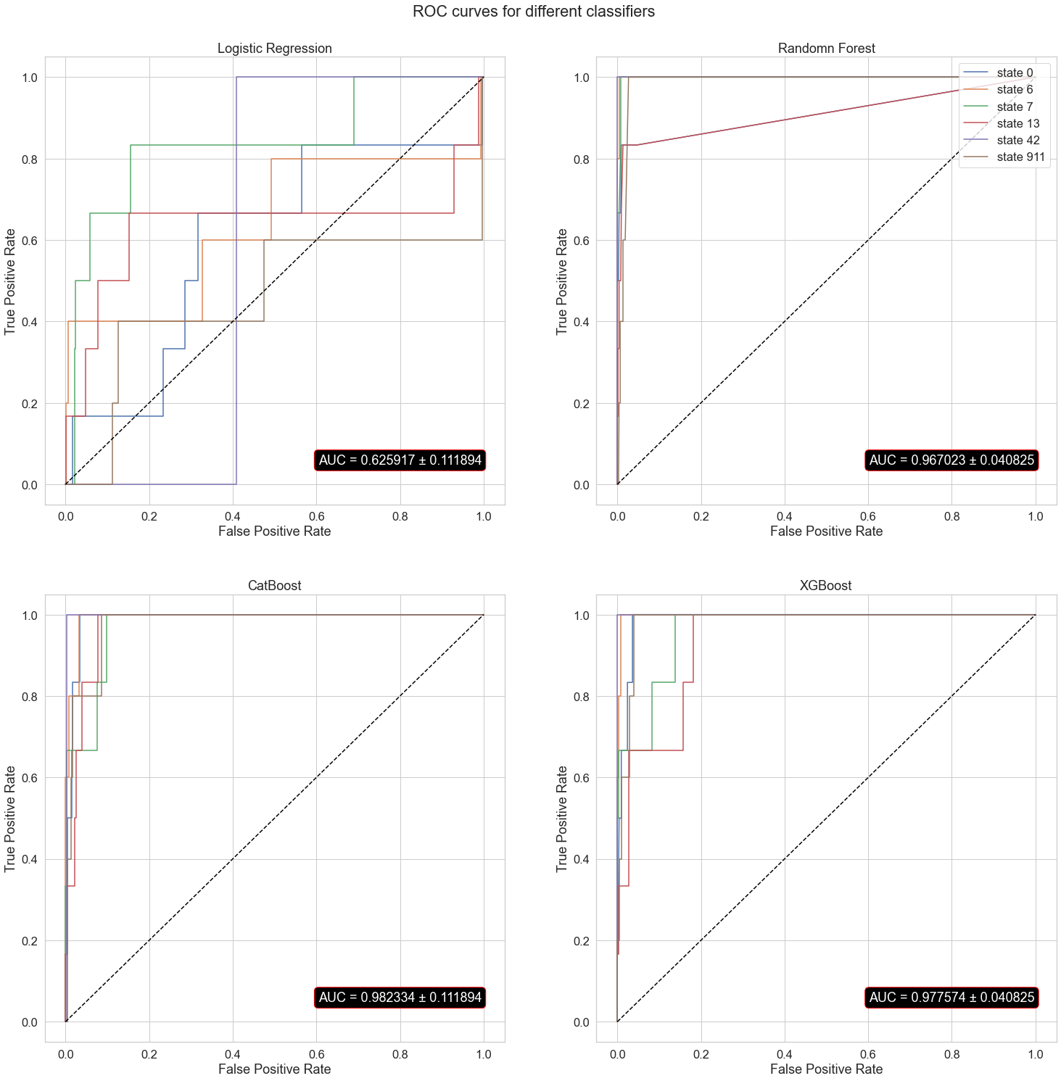
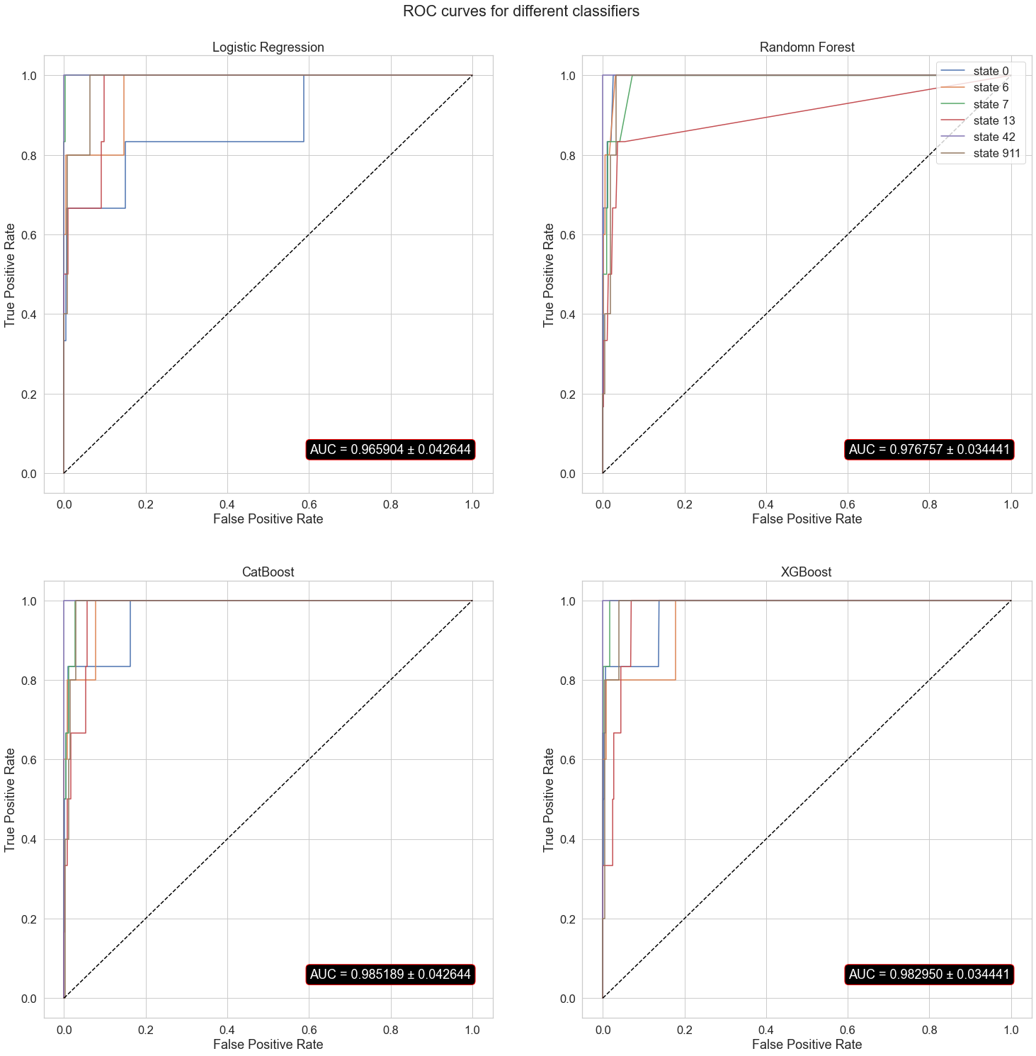
Before data processing
After data processing
Notes:
Classification improves for Logistic regression (‘cause some linear featires were added). But for other algorithms results are the same within the error.

Slide 10
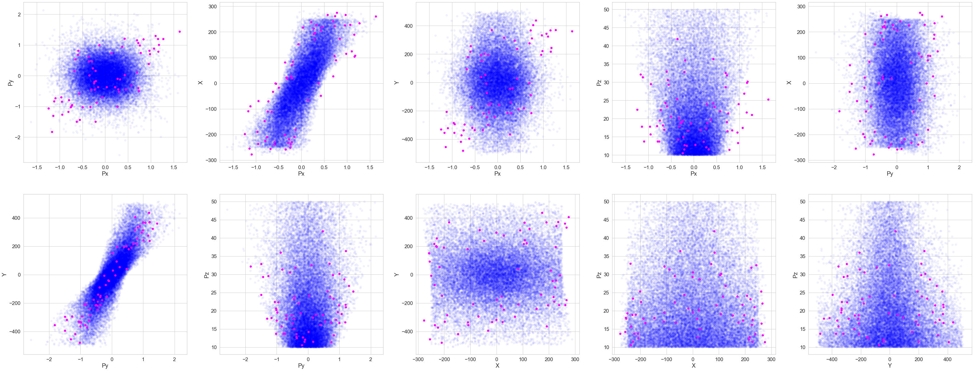
Second Group (10÷50 Mev)
Notes:
Same

Slide 11
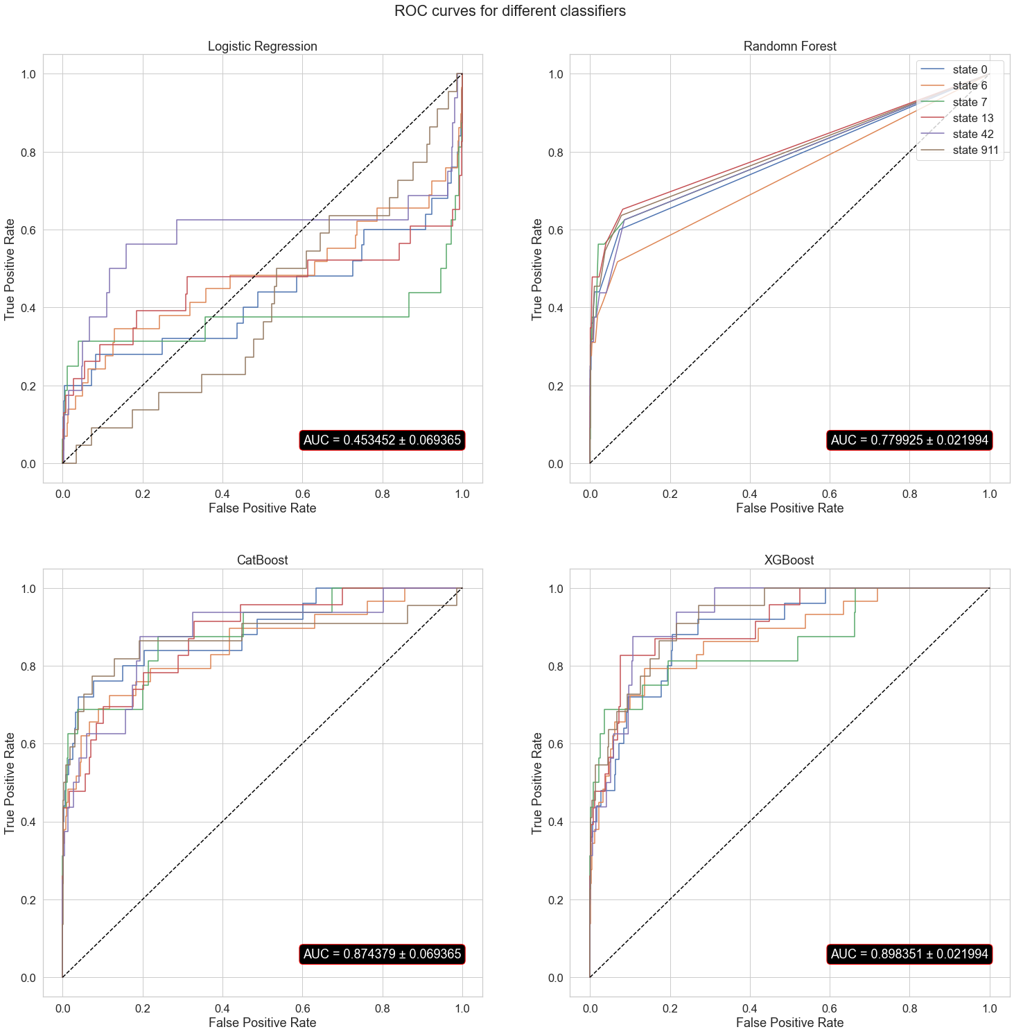
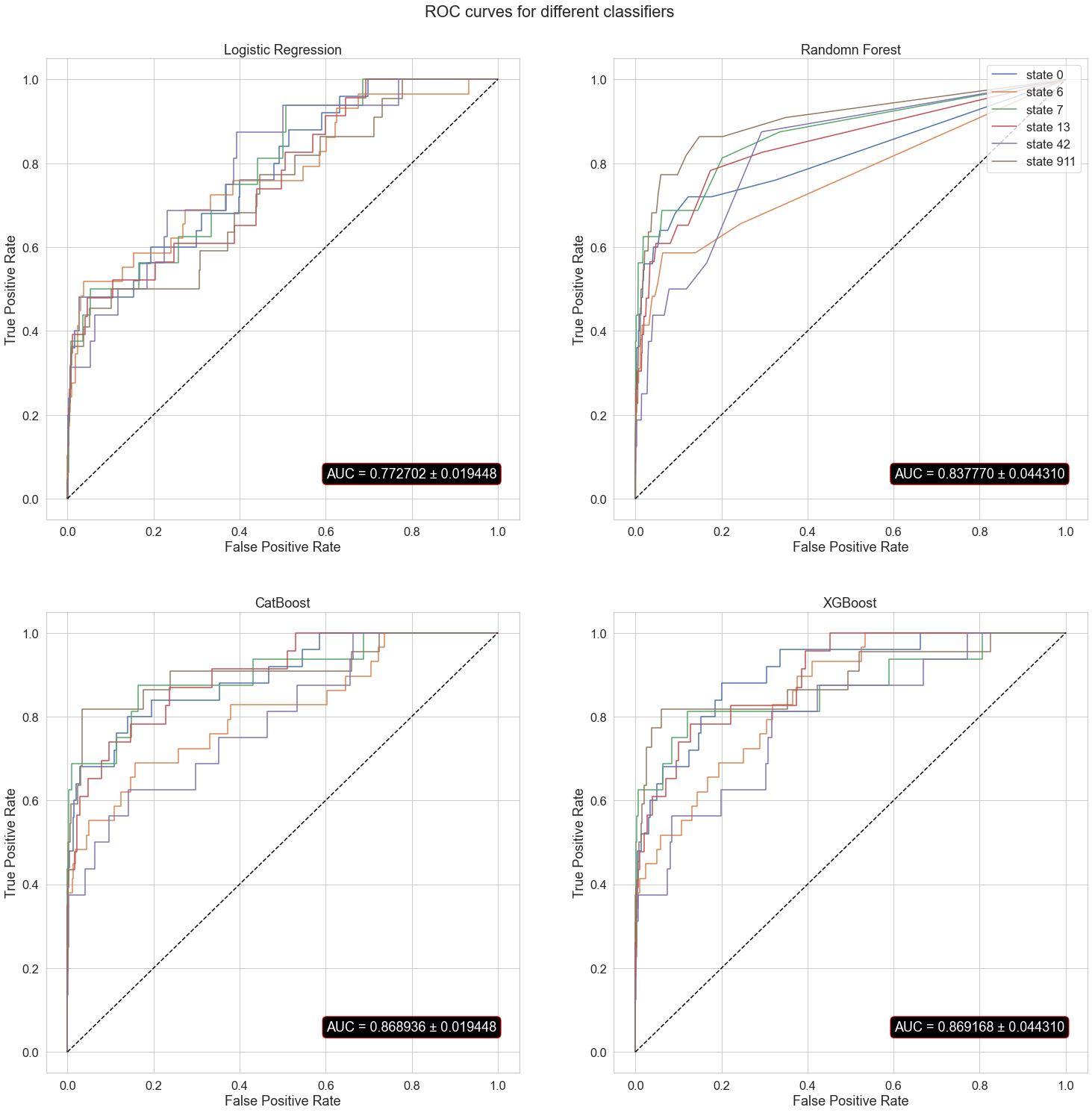
Before data processing
After data processing
Notes:
Same

Slide 12
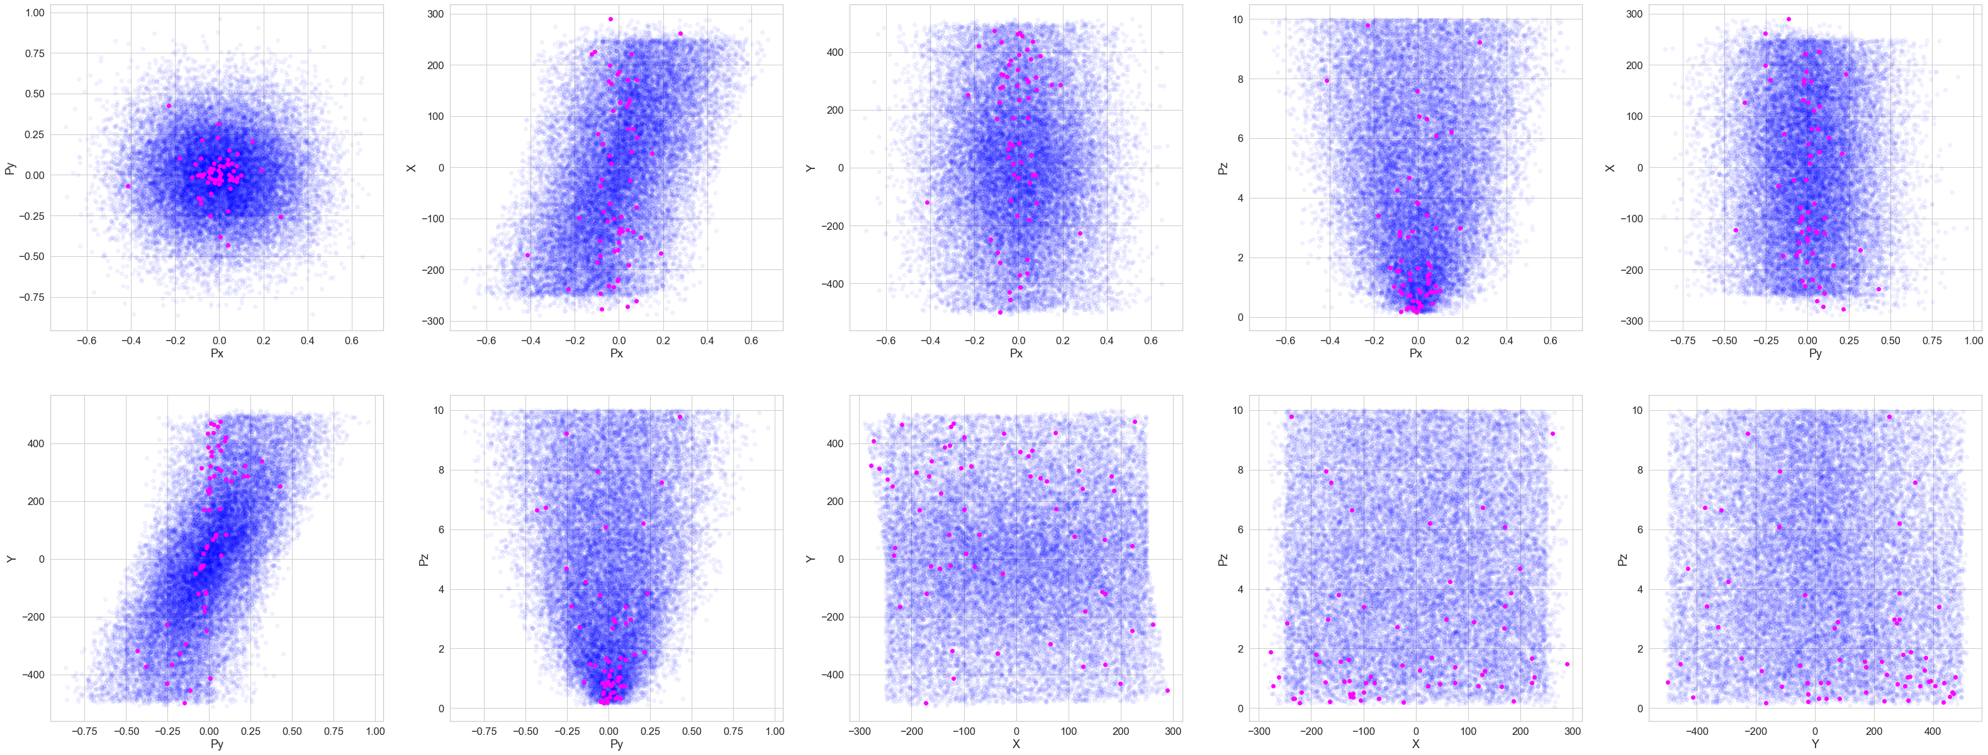
Third Group (<10 Mev)
Notes:
Same

Slide 13
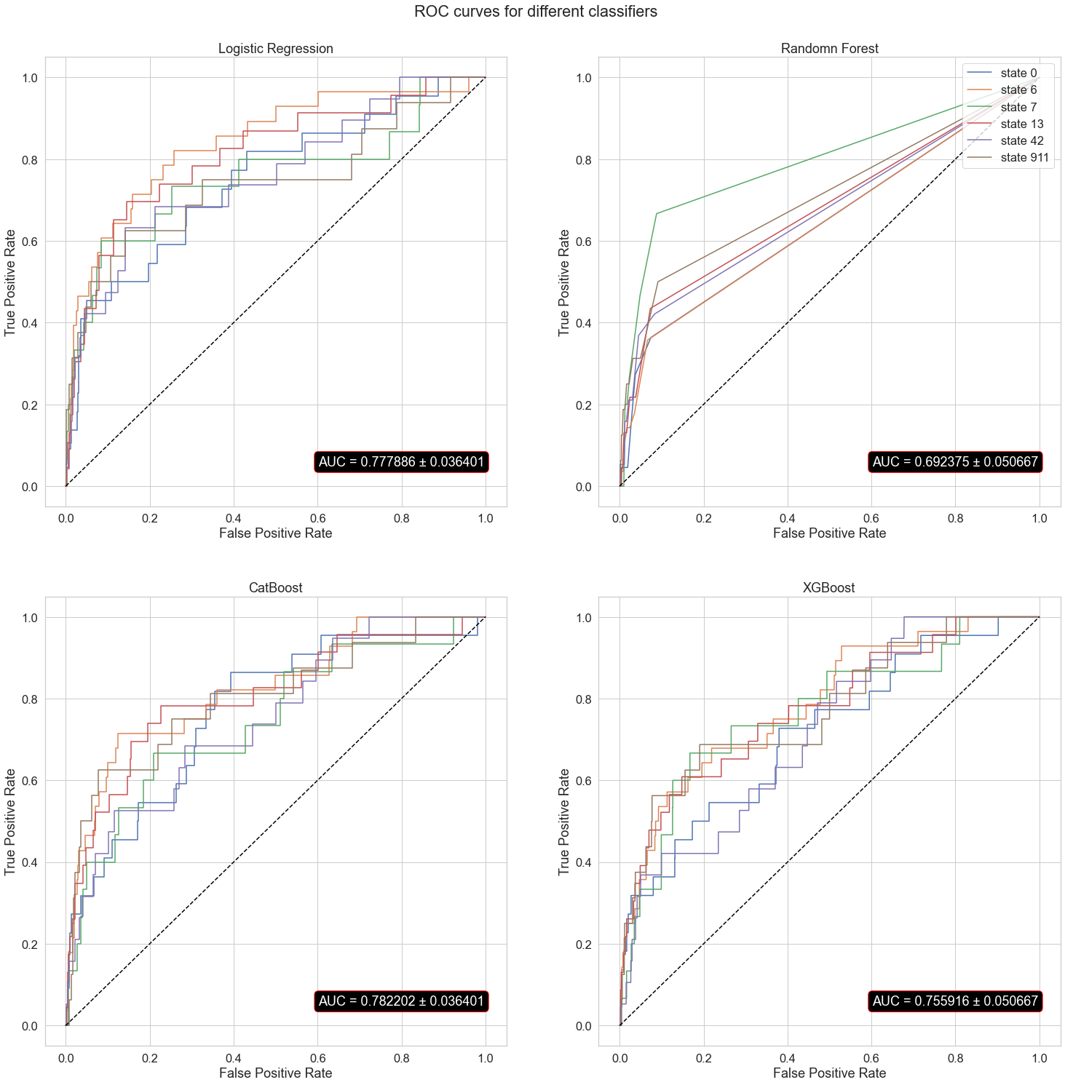
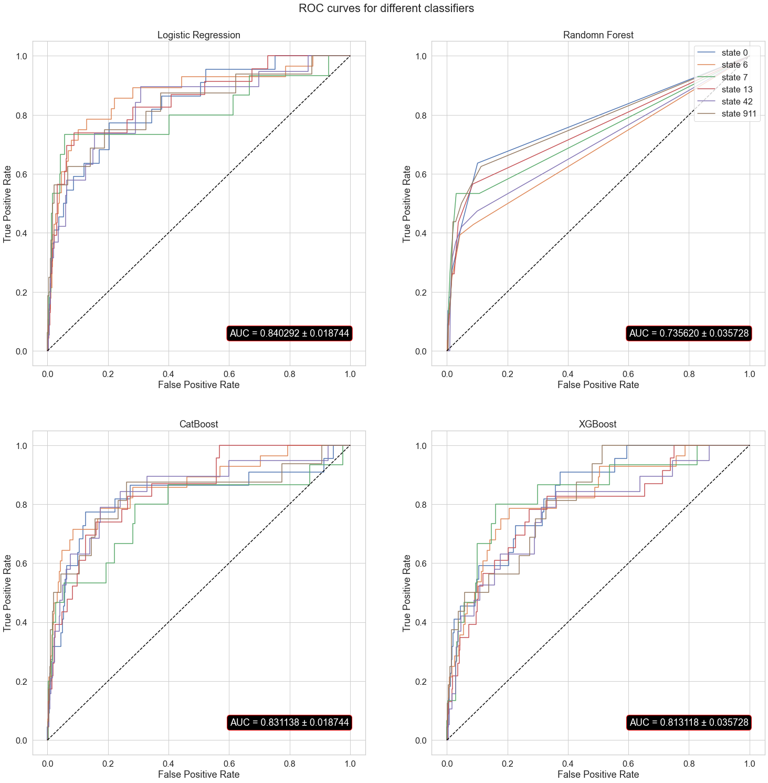
Before data processing
After data processing
Notes:
Same

Slide 14
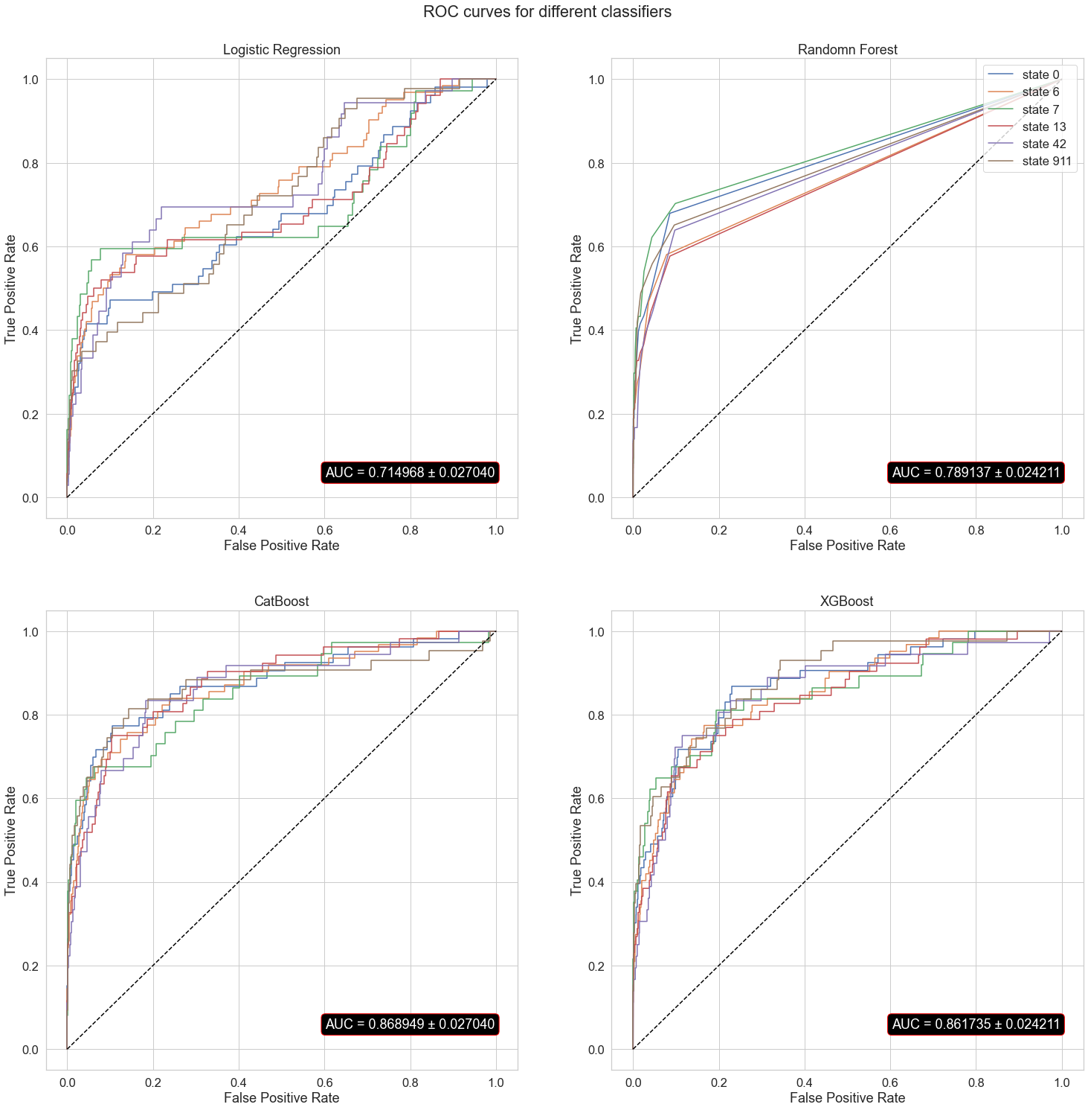
Overall Results
Final algorithm allows to reduce background
five times for 80% efficiency
two times for 90% efficiency
Notes:
The final results shows that gradient boosting algorithms predictions did not get better after data processing (but still shows better results then others). For logistic regression and random forest data processing helped improve the values of metrics.

